Slide 1
Data Divers
AI-Driven Music Recommendation Application
RecNN
MMP
Andrew Mark Dale
Abednego njani Ndegwa
Ashutosh Pandey
Darren Saguil
Nikhil Lohar

Slide 2
Work Completed
Since our AI model was completed for the last portion (MVP) of the project, we have focused mainly on introducing a more Spotify-oriented theme, as well as implementing the Spotify API.
Spotify-oriented theme
Logos.
General website theme.
Spotify API integrated into the system
Most time consuming part of this portion, getting everything integrated.
For this iteration of the project, the frontend and backend are hosted locally. They will be hosted on the cloud for the final presentation. We took a step backwards to take ten steps forward!
Backend now has more duties, this allows for a faster, more seamless experience.

Slide 3
Work Still Outstanding
To be completed by Final Presentation
Quality of life fixes. Our aim is to create a seamless experience for users, anything we can iron out will only benefit us.
Ensuring all potential error cases are handled properly.
Other small issues still outstanding.
Getting the entire project hosted on the cloud.
Implement regenerate song list.

Slide 4
Now for a demo of our application!

Slide 5
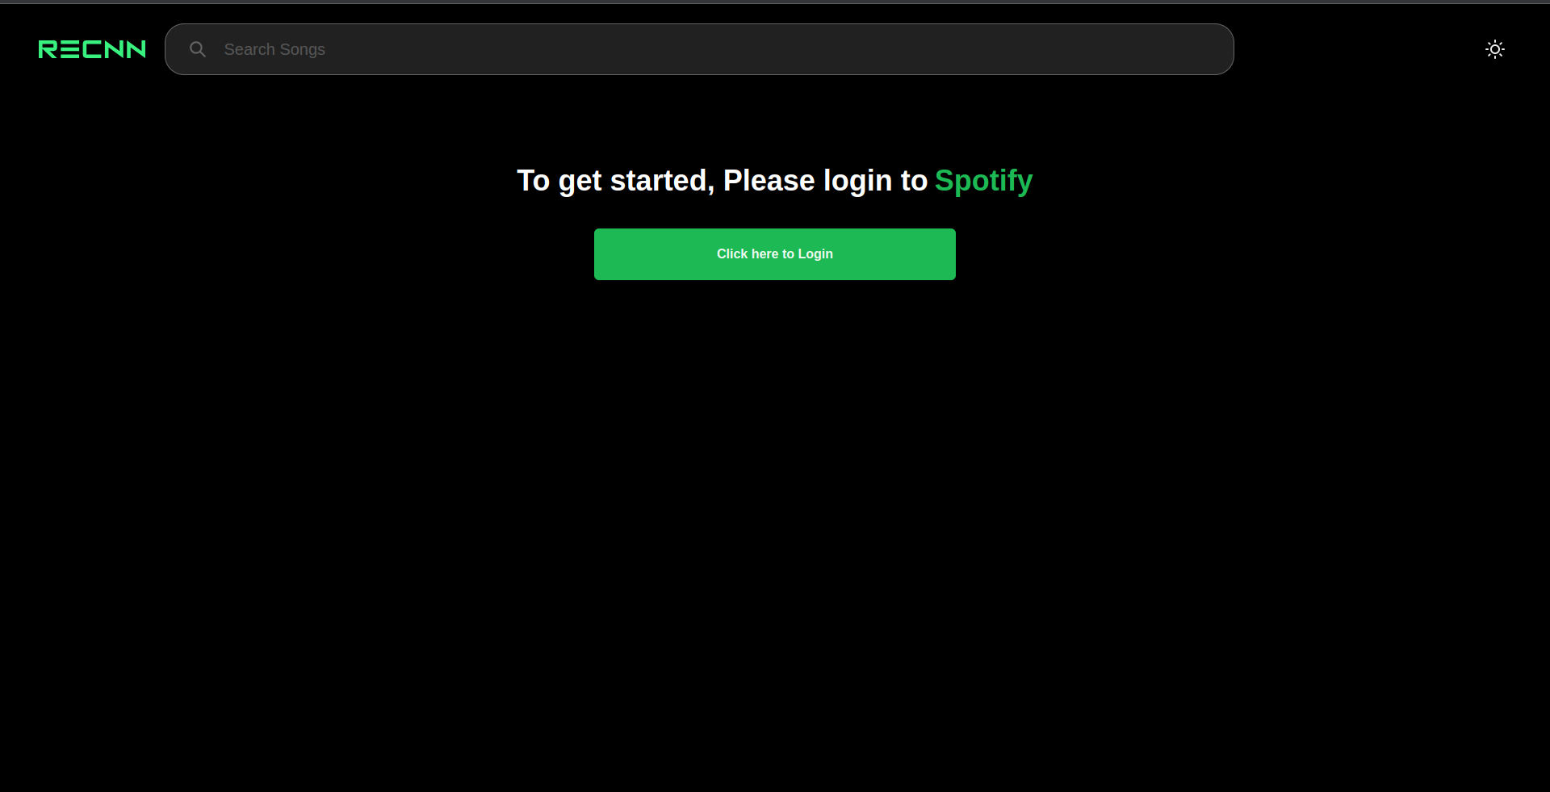
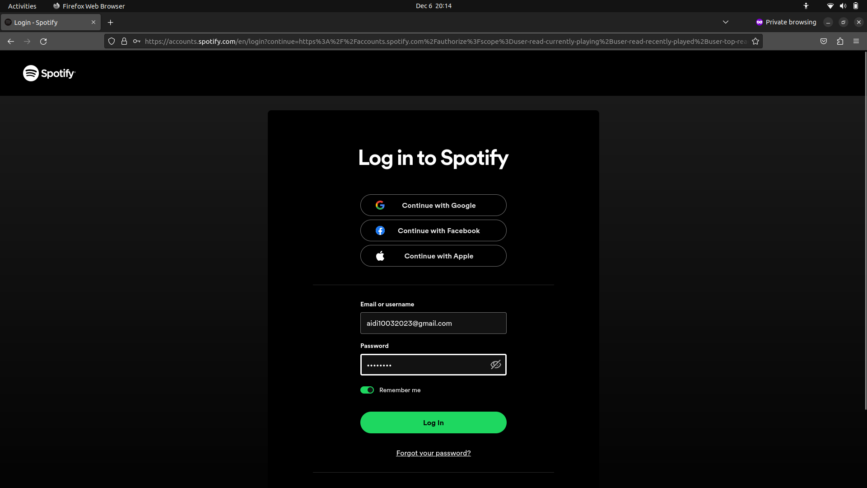
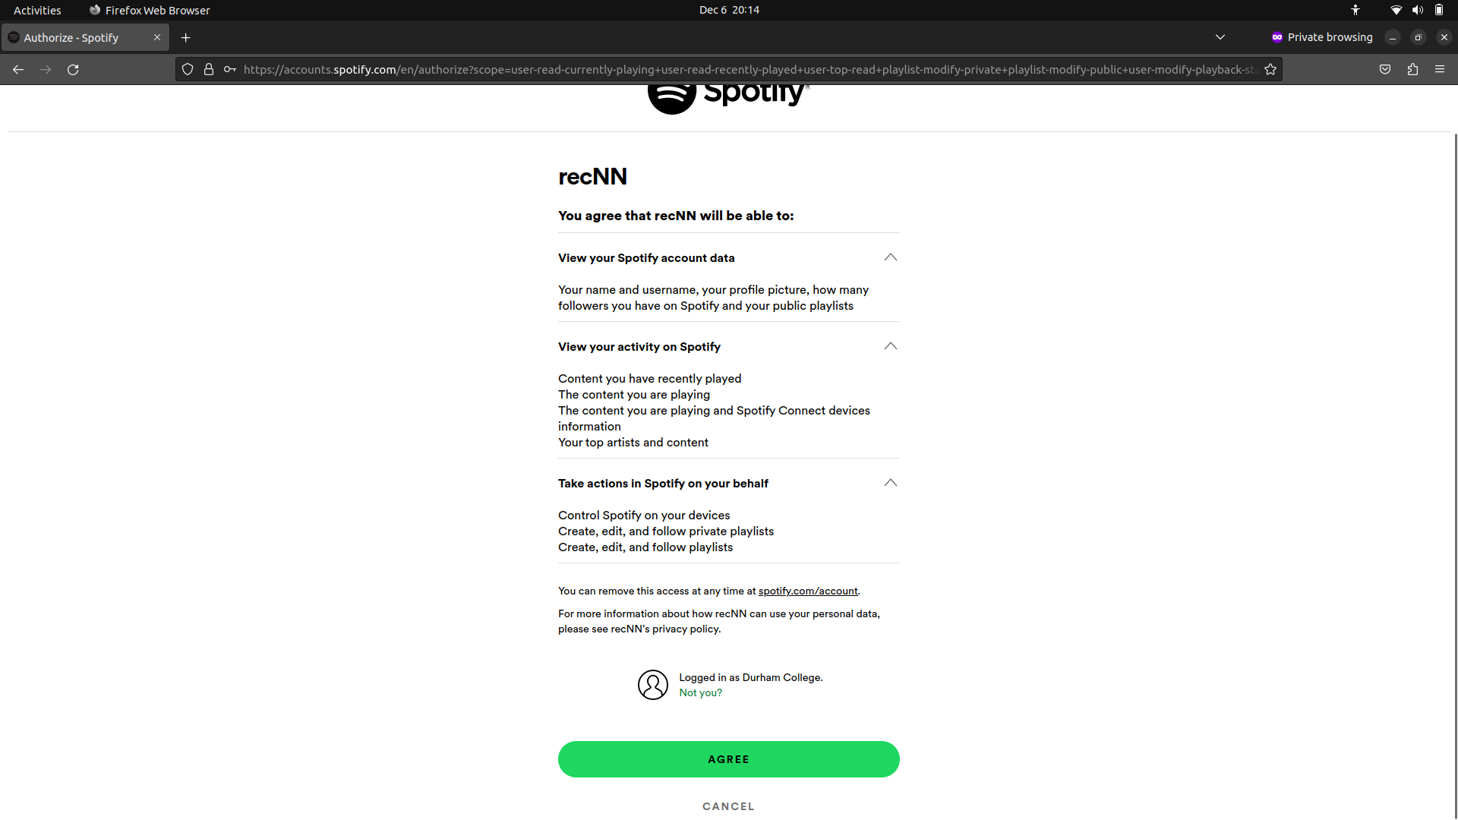
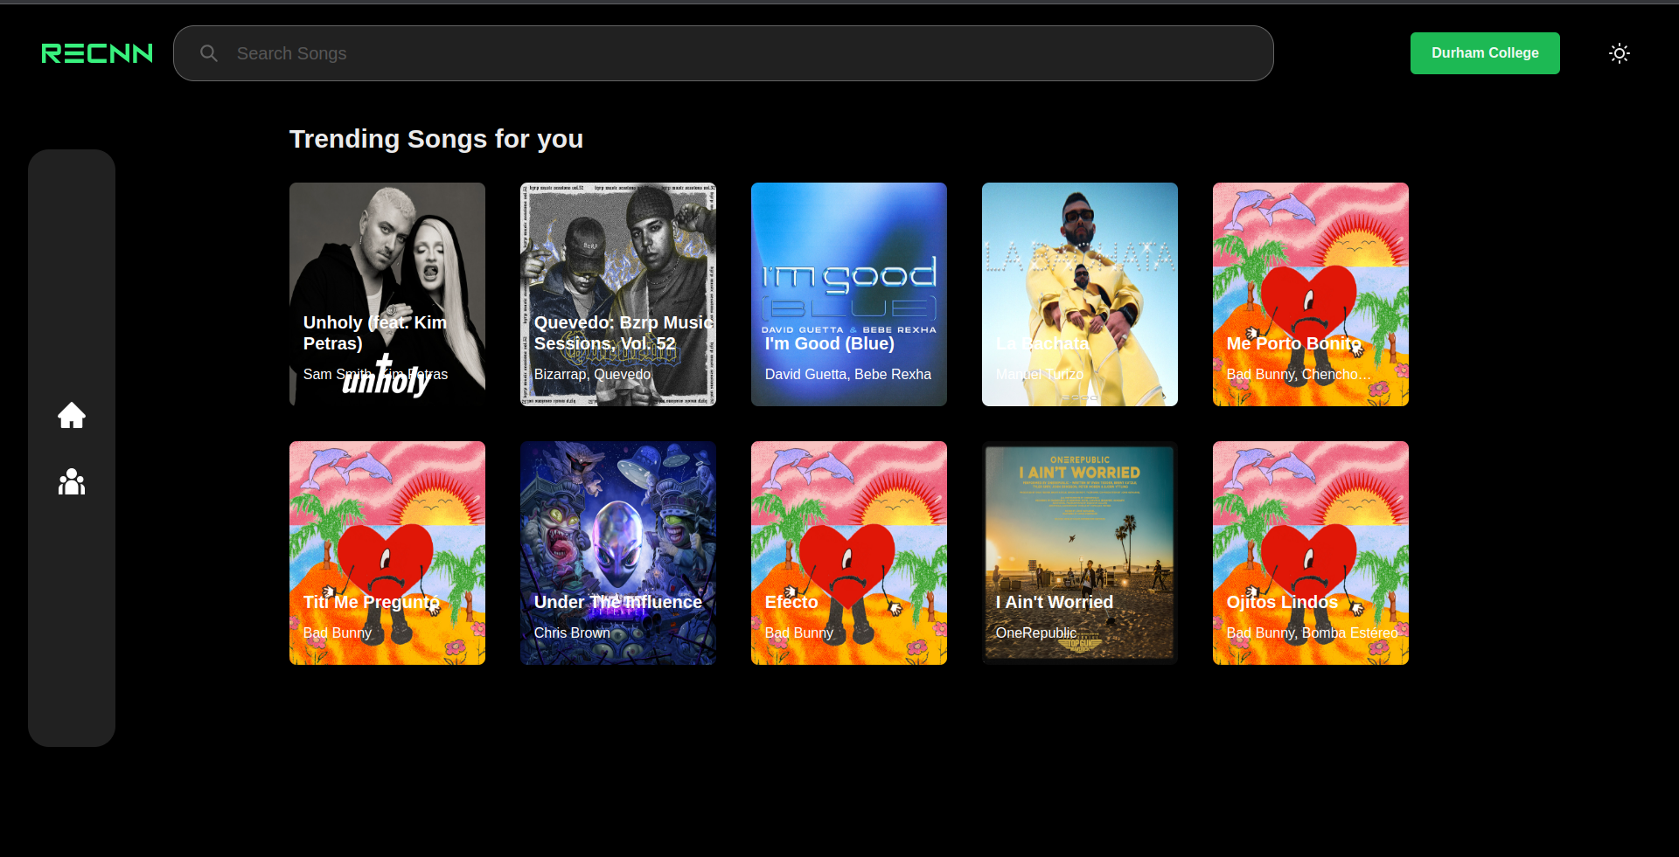
Step 1: To begin, the user is greeted with a page that informs them that they need to log in.
Step 2: The user then enters their login credentials.
Step 3: The user gives permission to our application. This allows us to create a playlist.
Step 4: Once logged in, the user can select a song to get recommendations for.

Slide 6
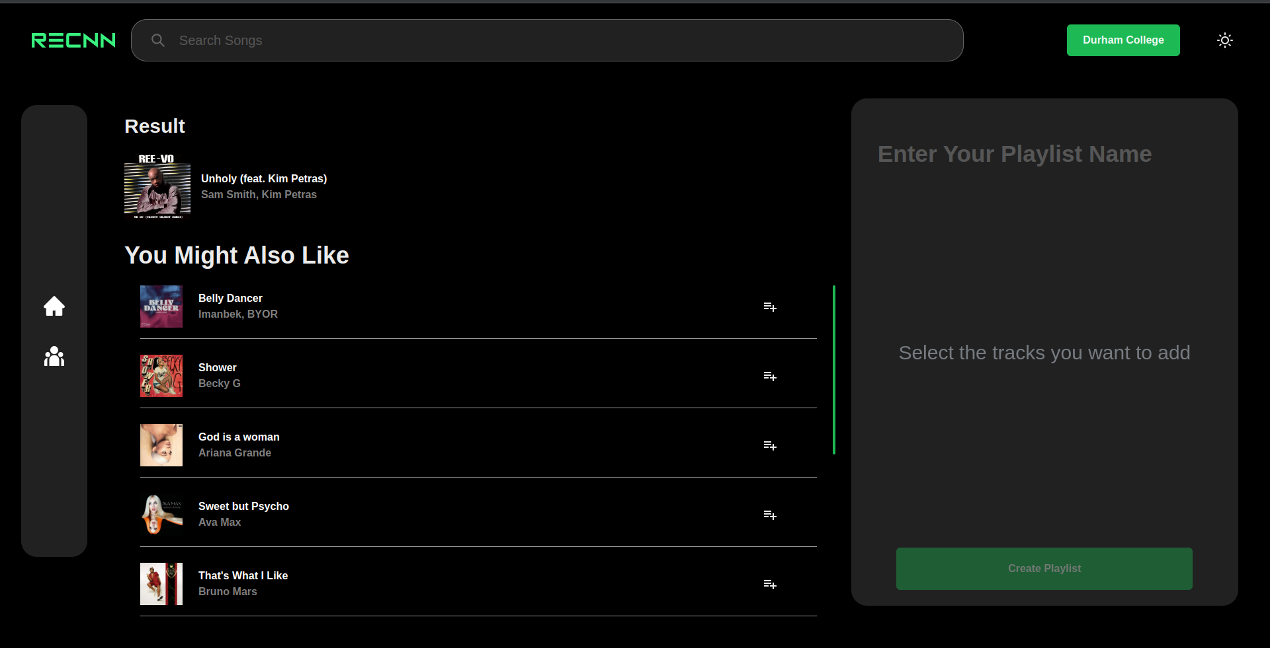
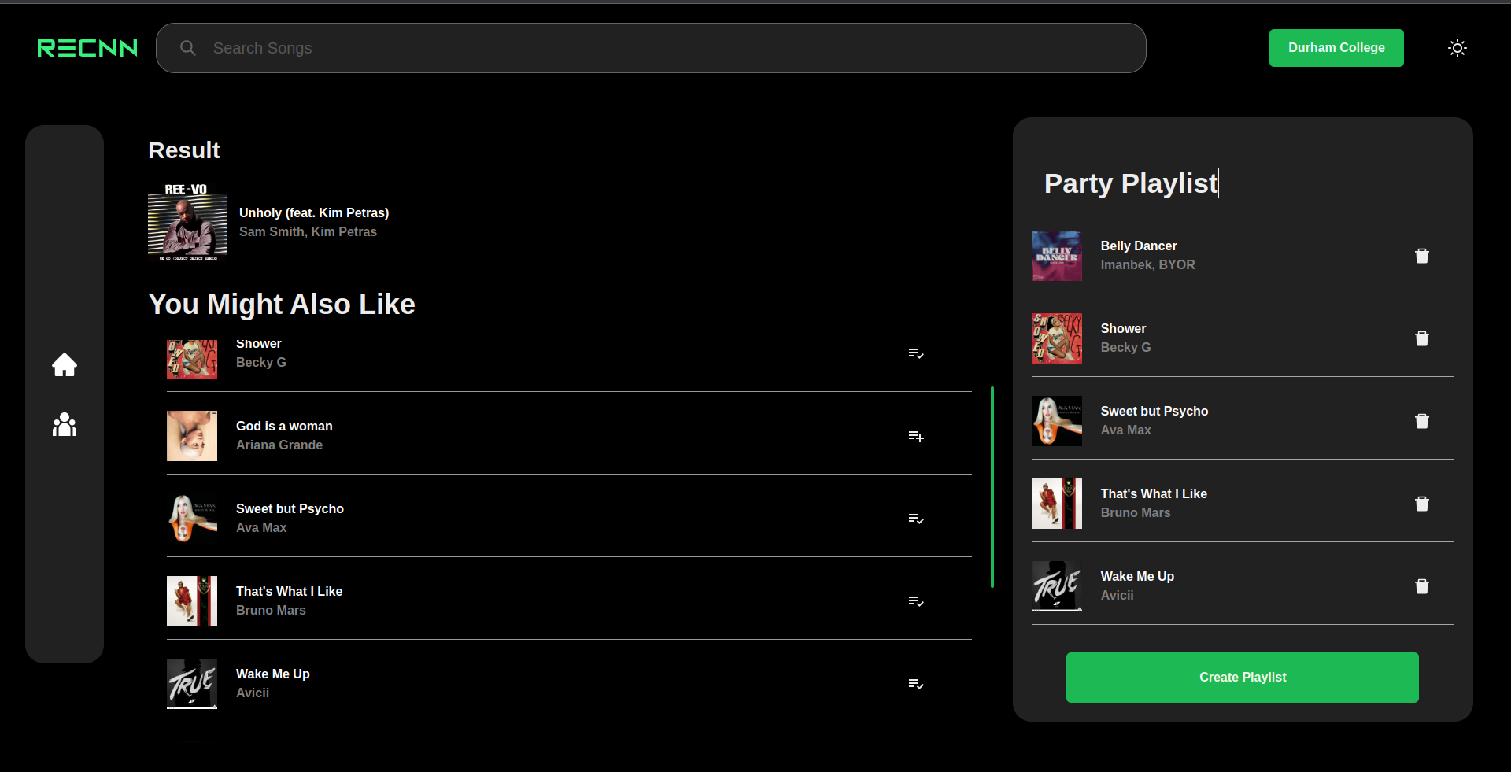
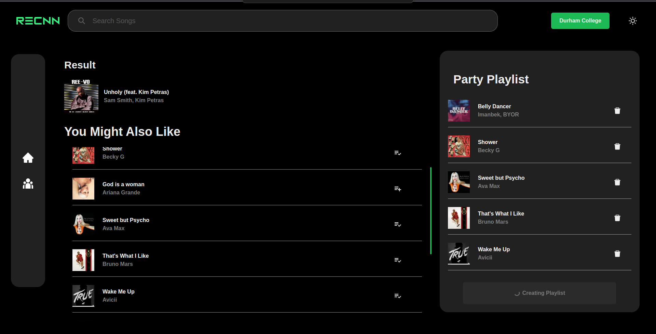
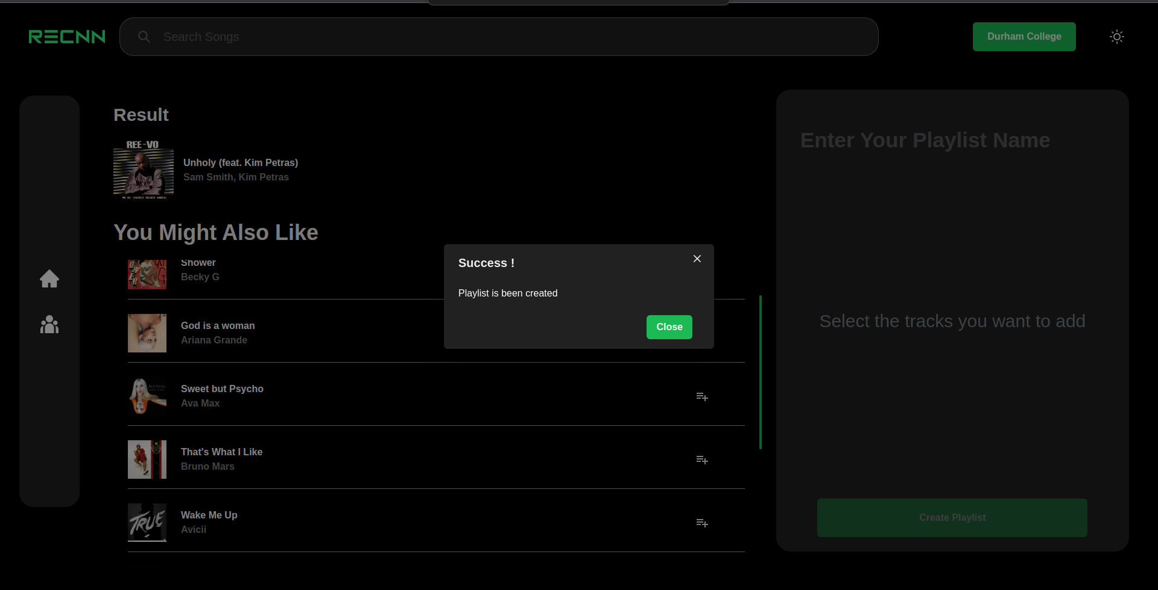
Step 5: The user has selected a song and is show recommendations .
Step 6: The user selects songs they want added to their playlist and enters a name.
Step 7: The user clicks Create Playlist.
Step 8: Viola! The playlist has been created!

Slide 7
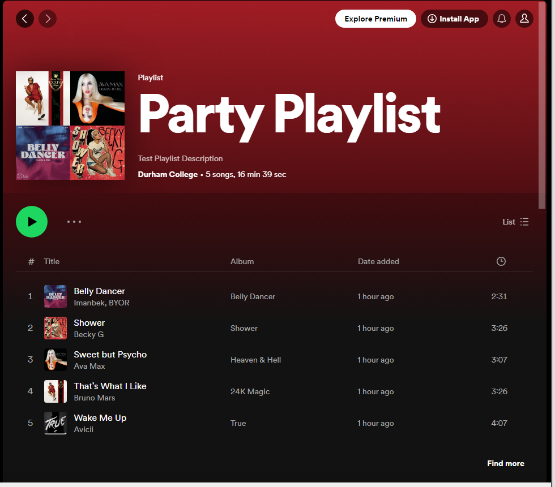
The playlist has been created!
Step 9: The user can now enjoy their AI-recommended playlist on their Spotify account!

